Slide 1

CASE STUDY: PROJECT OXYGEN
Managerial Behavior
He/she should be a good coach
Organized and team leading skills
Have well communication skills
Work toward the empowerment of the team
Focus on productive behavior and skills
Have a clear vision and strategy for their teams

Slide 2
According to the project, dubbed Project Oxygen, Google has identified effective characteristics of the managers. All data has been collected by reviews and surveys. By the above case study title points can be also be put like this, the best qualities a manager can have are:
Directing initiates action and helps in integrating efforts. Helps in bringing stability in organization and introducing changes.
Elements of directing are: motivation, supervision, communication, leadership.
Motivation helps in increasing the performance level of the employees and the overall organization. Helps in reducing the employees turnover of the company.
Supervision: process of overseeing and analyzing the efforts and activities of employees and timely guiding them through instructions and proper feedback to help them achieve organizational goals.
Communication: exchanging ideas, beliefs, philosophy, contents, etc. between an individual and the others in order to arrive at a common understanding.

Slide 3
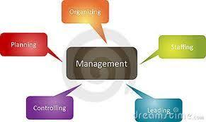

Leadership: influencing the behavior of employees by acting as a role model and inspiring them to work willingly towards the achievement of organizational goals.(who gets influenced and become followers)
Controlling Helps in accomplishing organizational goals and judging accuracy of set standards. Facilitates co-ordination in action.
Controlling is considered blind without planning as it is planning which sets standards for controlling and acts as a torch bearer.
Planning: Is deciding in advance what to do, how to do it, when to do it and who to do it. It is a Forward looking process.
Planning bridges the gap from where we are and to where we want to go.
Significance: Establishing goals, Team building, Managing risk and uncertainty.
Decision Making is defined as the process of choosing among alternatives .
It is an integral part of planning.
Decision making is perhaps the most important component of a manager’s activities.

Slide 4
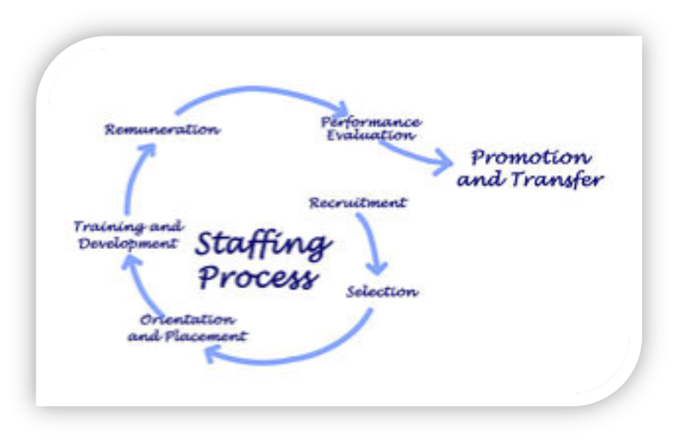
Staffing (management of managers) is to fit employees into positions based on their experience and qualification.
Right person to right job=maximum productivity and higher performance rate. (growth of a company)
Training and developing the existing personnel for career advancement and betterment of company's future. (reasonable income to the organization)

Slide 5
Conclusion :To conclude we can tell that managers are the pillars of organization and they set an example to other companies. People have higher expectations on google and they show that employees of other companies also should keep up the same pace like them to succeed parallelly.
PRESENTED BY:
VARIDHI
RAMYA R
SHEWANI
VYJAYANTHI K.S --------- THANK YOU---------

